Slide 2
l
This is a sample report, so identifiable content has been blacked out for privacy.
VS
yourdomain.com
KEY COMPETITORS

Slide 3
SERPSTAT Website Overview
The first section has data on:
Website Google top 20 keyword visibility (ordinarily blank)
Your Estimated Search Traffic
The of your website’s top 100 keywords
The number of your paid keywords if any
Your top 5 keywords ranked by position
Your Keyword rank distribution
A list of your subdomains if any.
The second section has data on:
Your traffic trends
Your keyword trends
The third section of your report shows your top pages.
The fourth section shows you a list of your organic competitors.

Slide 4
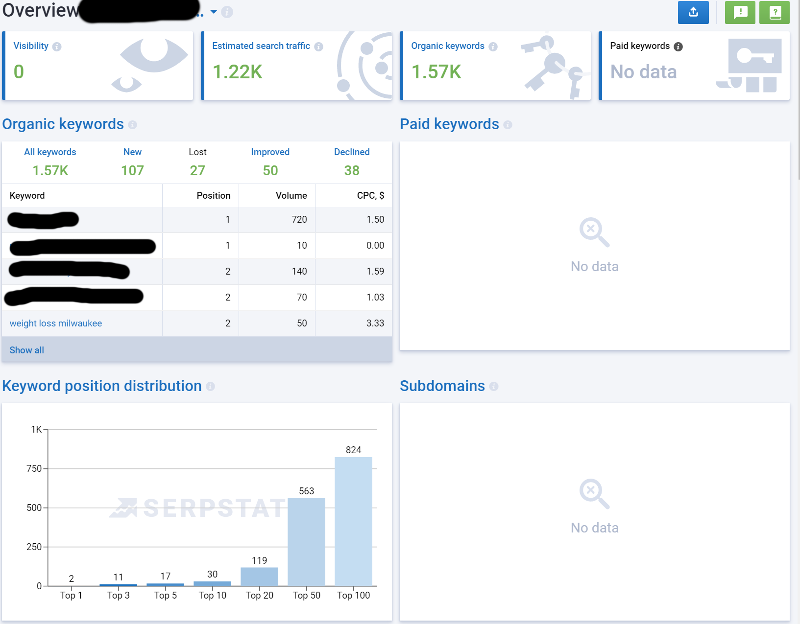
SERPSTAT OVERVIEW 1

Slide 5
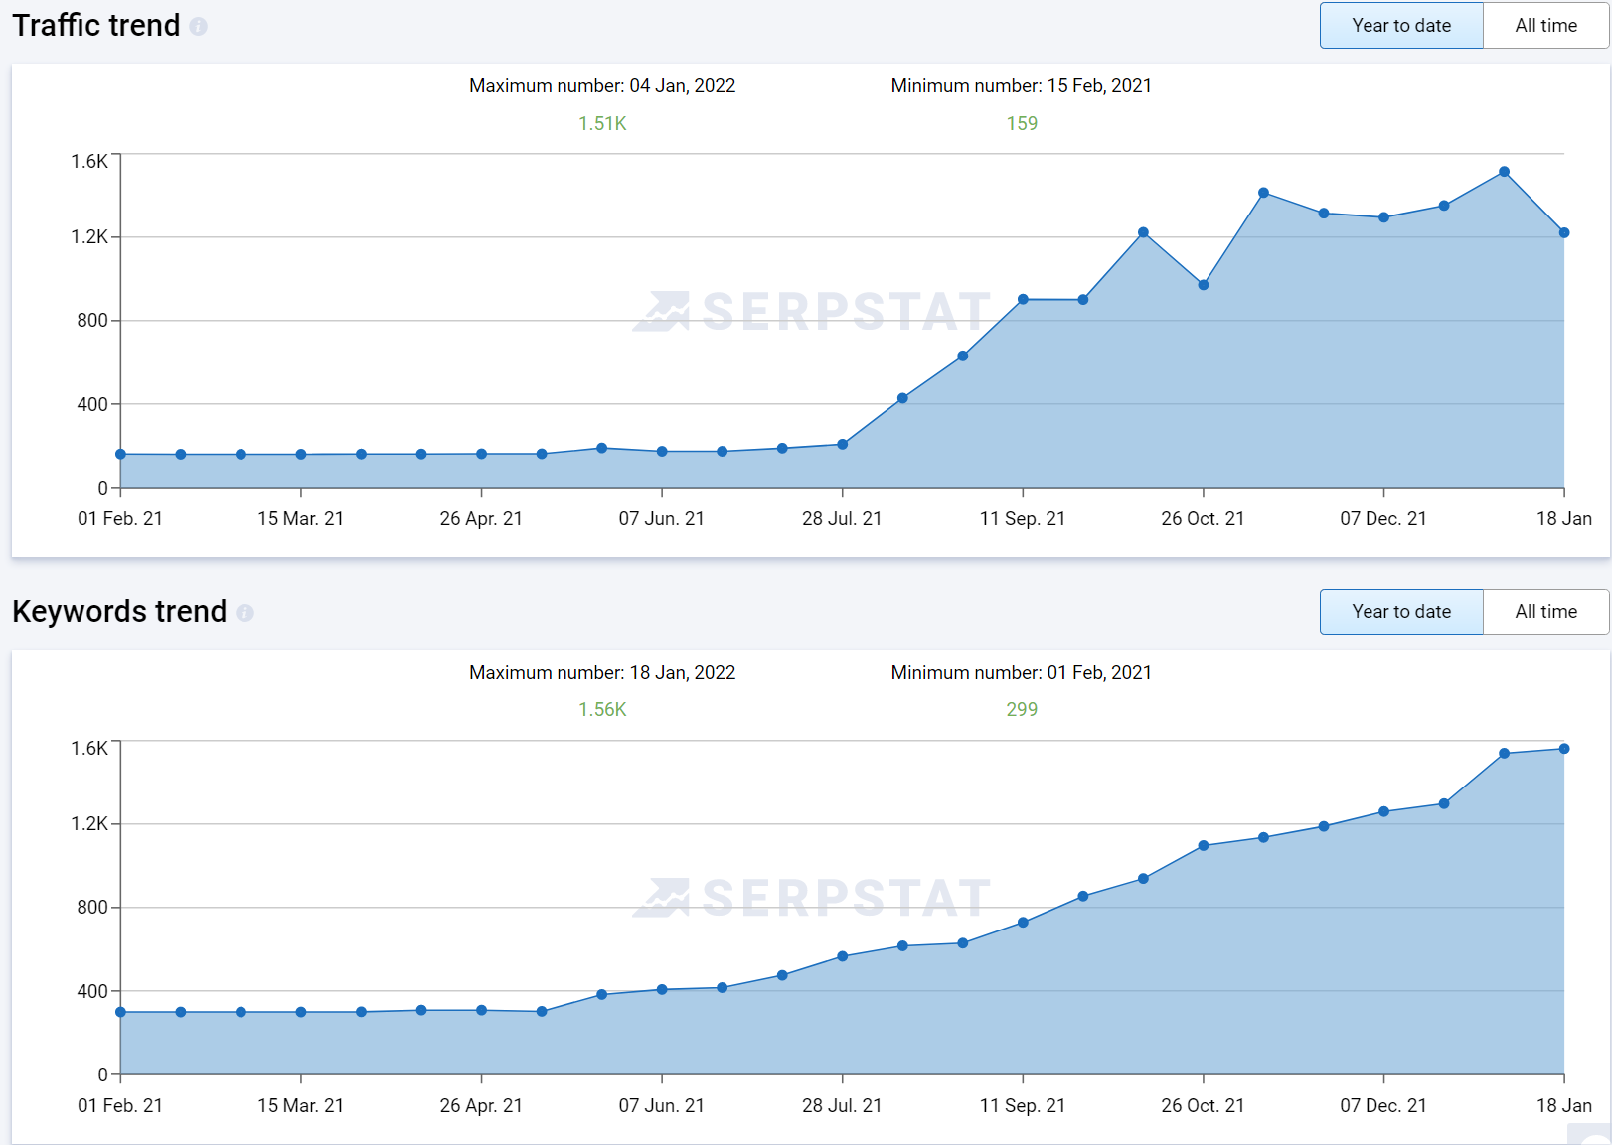
SERPSTAT OVERVIEW 2

Slide 6
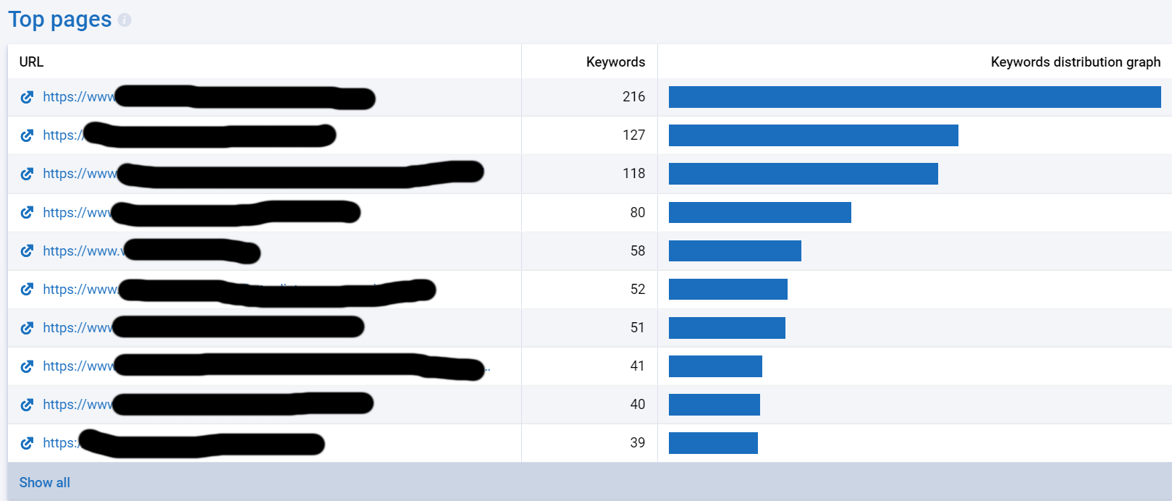
SERPSTAT OVERVIEW 3

Slide 7
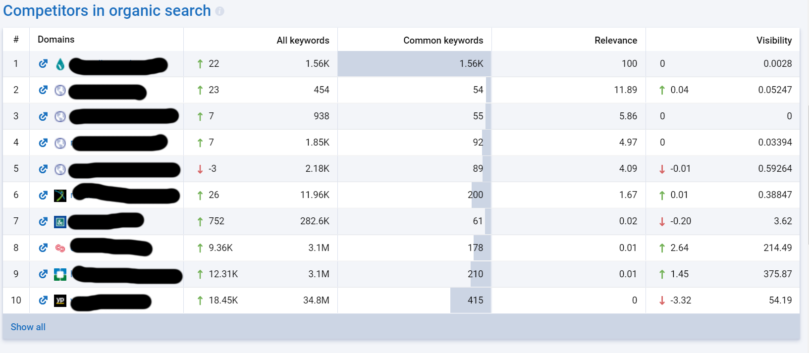
SERPSTAT OVERVIEW 4

Slide 8
This is a sample report, so identifiable content has been blacked out for privacy.
Site Audit
A report from SEMRUSH that shows technical issues on your website that can affect your search performance and user experience

Slide 9
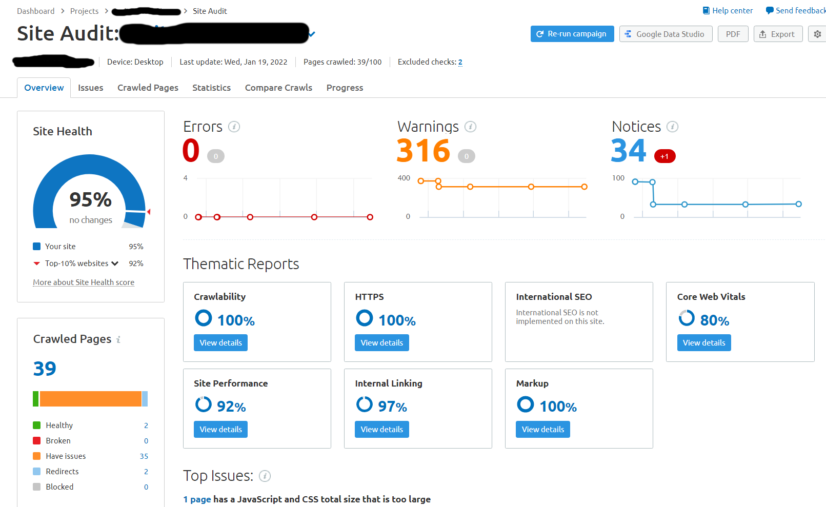
Technical Site Audit

Slide 10
This is a sample report, so identifiable content has been blacked out for privacy.
Your Top Search Keywords
A list of your top 15 keywords. This list will let you know if you are over relying on branded search terms.

Slide 11
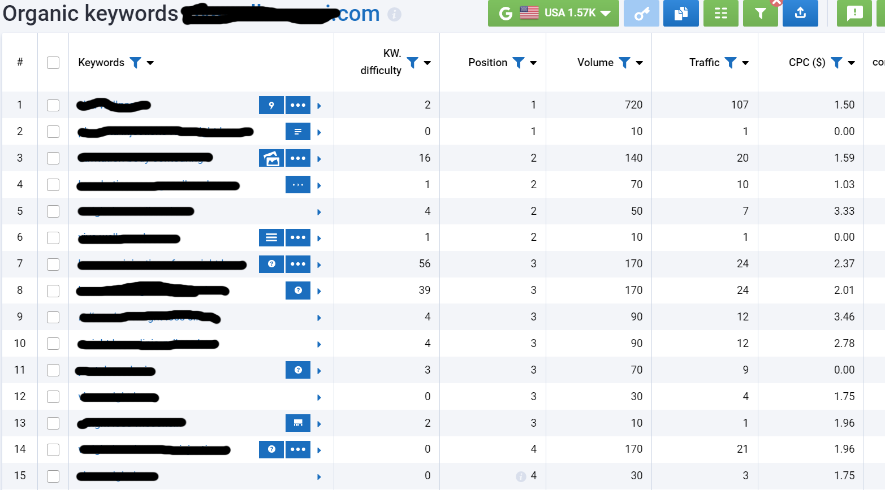
Your Top Keywords

